Slide 1
PROBLEM STATEMENT
We have a client who has a website where people write different reviews for technical products. Now they are adding a new feature to their website i.e. The reviewer will have to add stars(rating) as well with the review. The rating is out 5 stars and it only has 5 options available 1 star, 2 stars, 3 stars, 4 stars, 5 stars. Now they want to predict ratings for the reviews which were written in the past and they don’t have a rating. So, we have to build an application which can predict the rating by seeing the review.
PROBLEM UNDERSTANDING
These days where lot of information generating every day in different form, some are like in text, audio, video. We must be aware that E-commerce industry has grown and keep on growing day by day. There are many e-commerce retailers like Amazon, Flipkart, eBay etc are present in market and giving competition to each other to gain maximum market share. So, customer review or sentiment plays very important role to know more about the product or service. Customer review provide very useful information for the company which they can work on and improve their product or services. Here machine learning model could help them to get deeper insight on customer review and provide some meaningful information to build business strategy about the product or services.

Slide 2
EDA STEPS ,VISUALIZATIONS,FINALIZED MODEL AND CONCLUSION
Variable identification.
Data Preprocessing.
Feature Engineering.
Data Exploration.
Principal Components Analysis
T-Distributed Stochastic Neighbor Embedding (t-SNE)
Model Development and Evaluation
Word Cloud
Conclusion

Slide 3
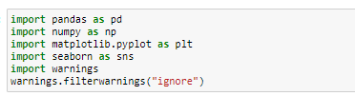
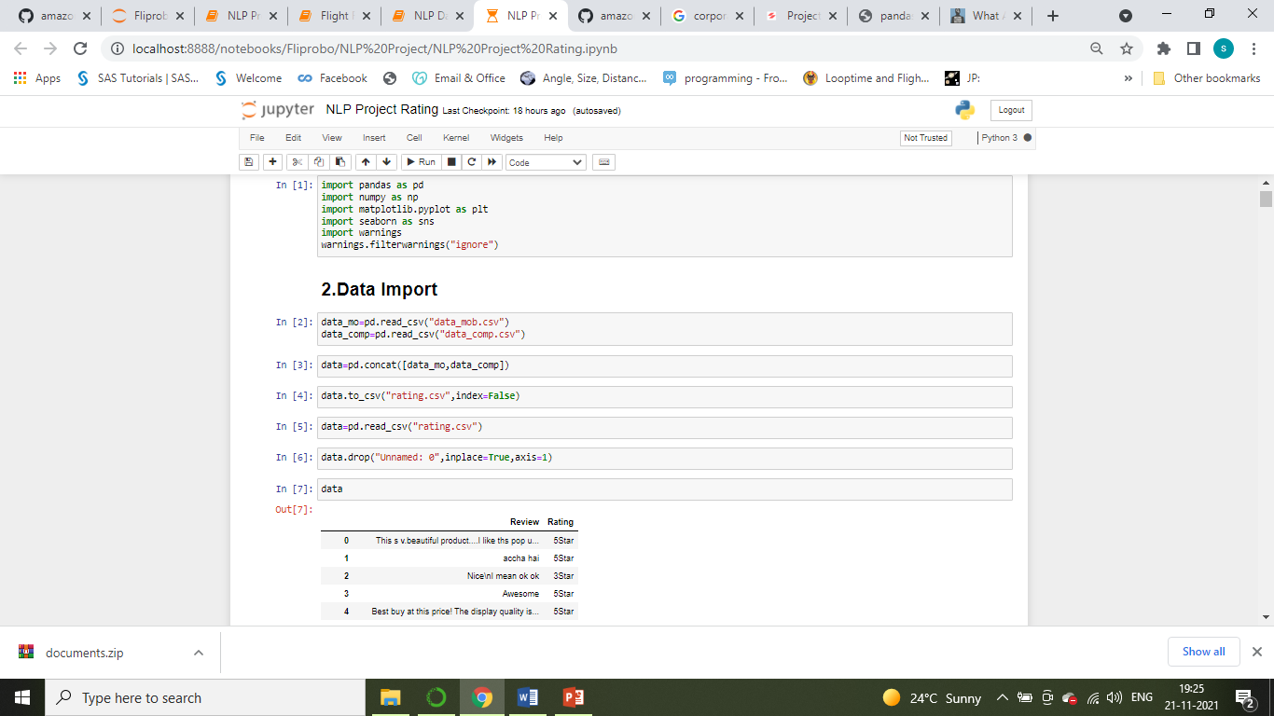
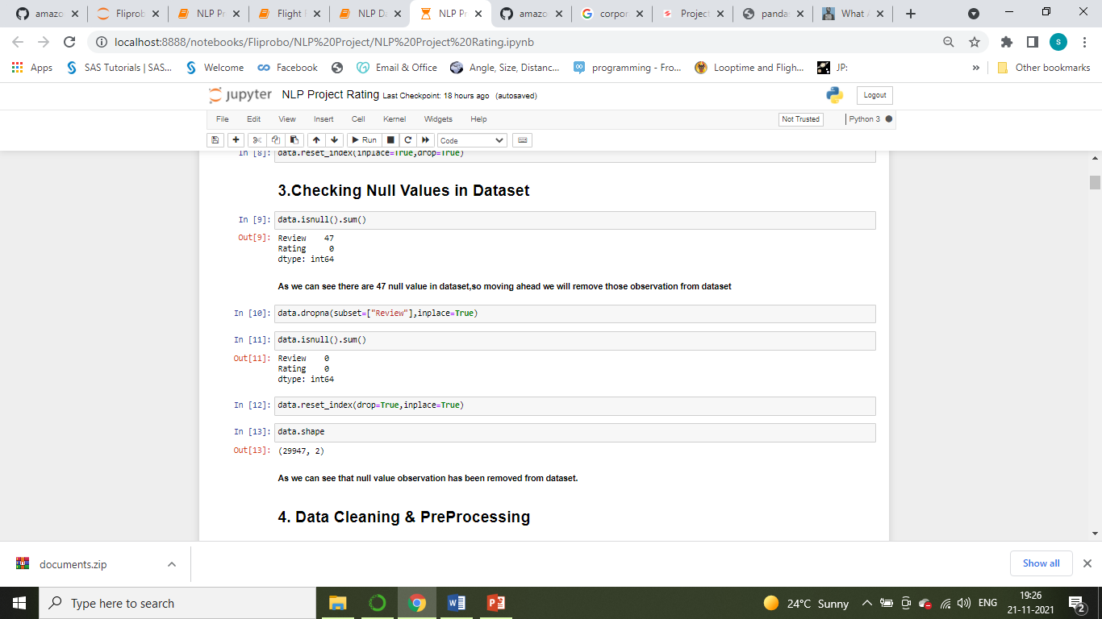
Variable identification.
Importing Libraries:
Importing Dataset:
Size of the dataset:

Slide 4
Data Pre Processing.
Following are the step followed for Data Pre processing in the dataset:
Removing Extra character.
Removing Punctuations.
Converting to lower case.
Removed Stop words.
Removing extra spaces and digit.
Apply Tokenization and Lemmatization NLP Algorithm.
Dealing with null value

Slide 5
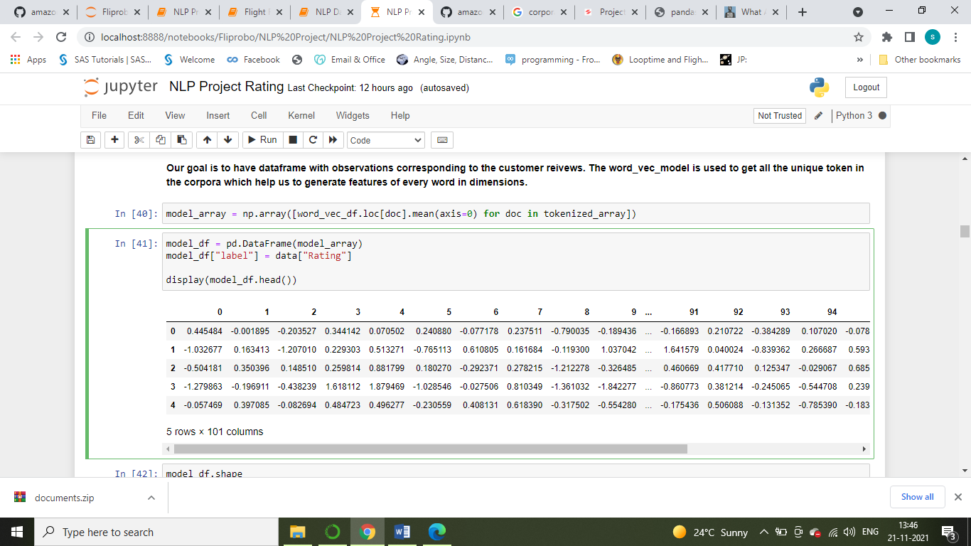
Feature Engineering.
Since we have only one feature columns, so we need to extract relevant information from the text document, where we have applied various NLP based algorithm and also since our feature columns in text format we have done word vectorized with Word2Vec algorithm.
Here we have created dataframe with observations corresponding to the customer reviews. The word_vec_model is used to get all the unique token in the corpora which help us to generate features of every word in dimensions as shown in below Fig.

Slide 6
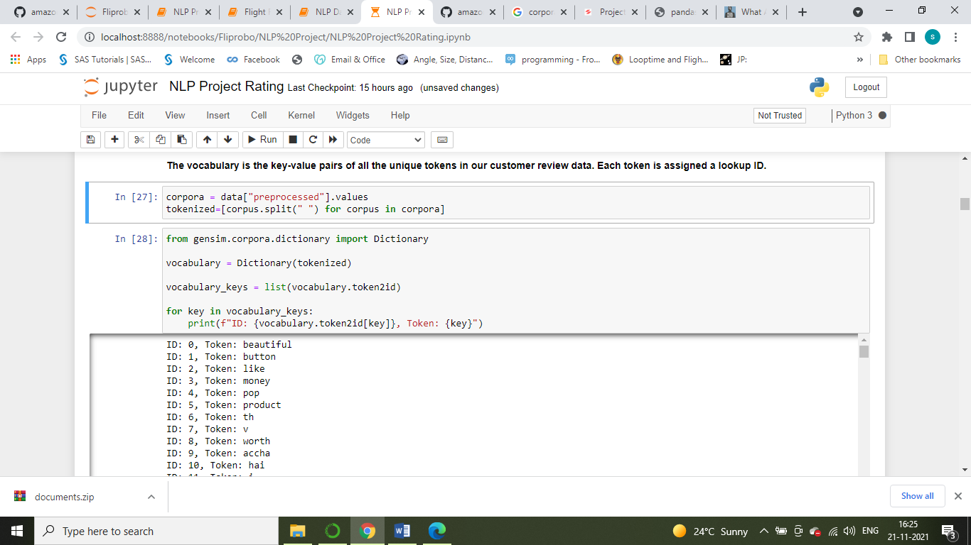
Feature Engineering.
Creating Vocabulary:
The vocabulary is the key-value pairs of all the unique tokens in our customer review data. Each token is assigned a lookup ID as shown in below figure.

Slide 7
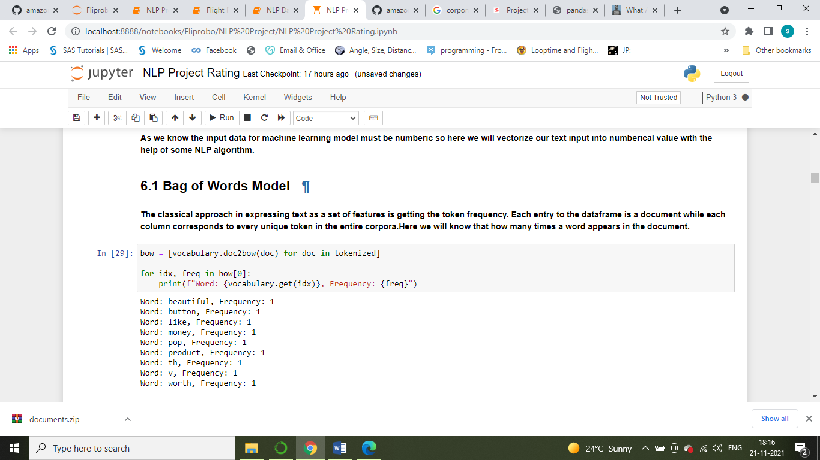
Feature Engineering.
Bags of Words Model:
The classical approach in expressing text as a set of features is getting the token frequency. Each entry to the dataframe is a document while each column corresponds to every unique token in the entire corpora. Here we will know that how many times a word appears in the document as shown in below figure.

Slide 8
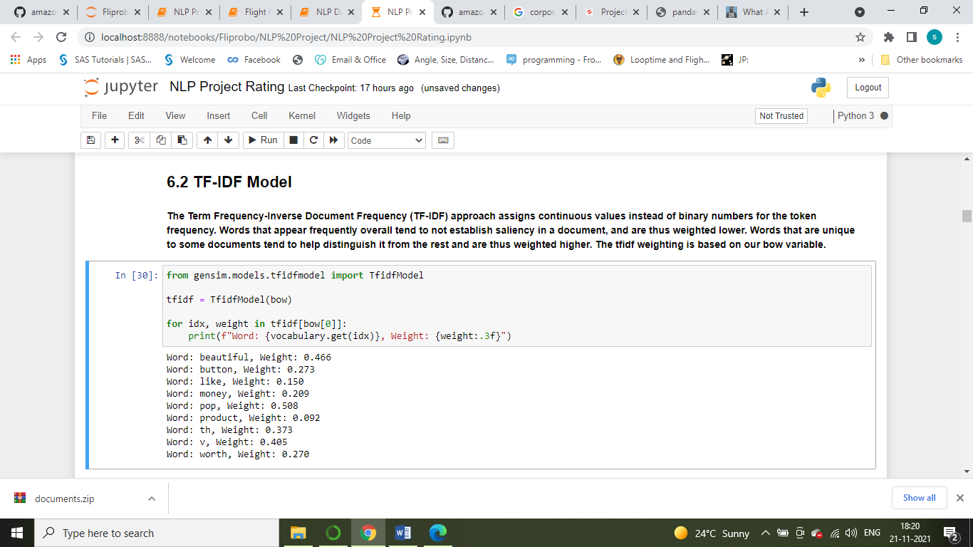
Feature Engineering.
TF-IDF model:
The Term Frequency-Inverse Document Frequency (TF-IDF) approach assigns continuous values instead of binary numbers for the token frequency. Words that appear frequently overall tend to not establish saliency in a document, and are thus weighted lower. Words that are unique to some documents tend to help distinguish it from the rest and are thus weighted higher. The Tf-idf weighting is based on our bow variable as shown in below figure.

Slide 9

Data Exploration:
In this Section we have visualized the features with various graph and plot to understand or analyse our features for our model.
Word2vec:
Here we tried to find the most similar word from the word bank which we have given to the model to find the similar word for these.

Slide 10
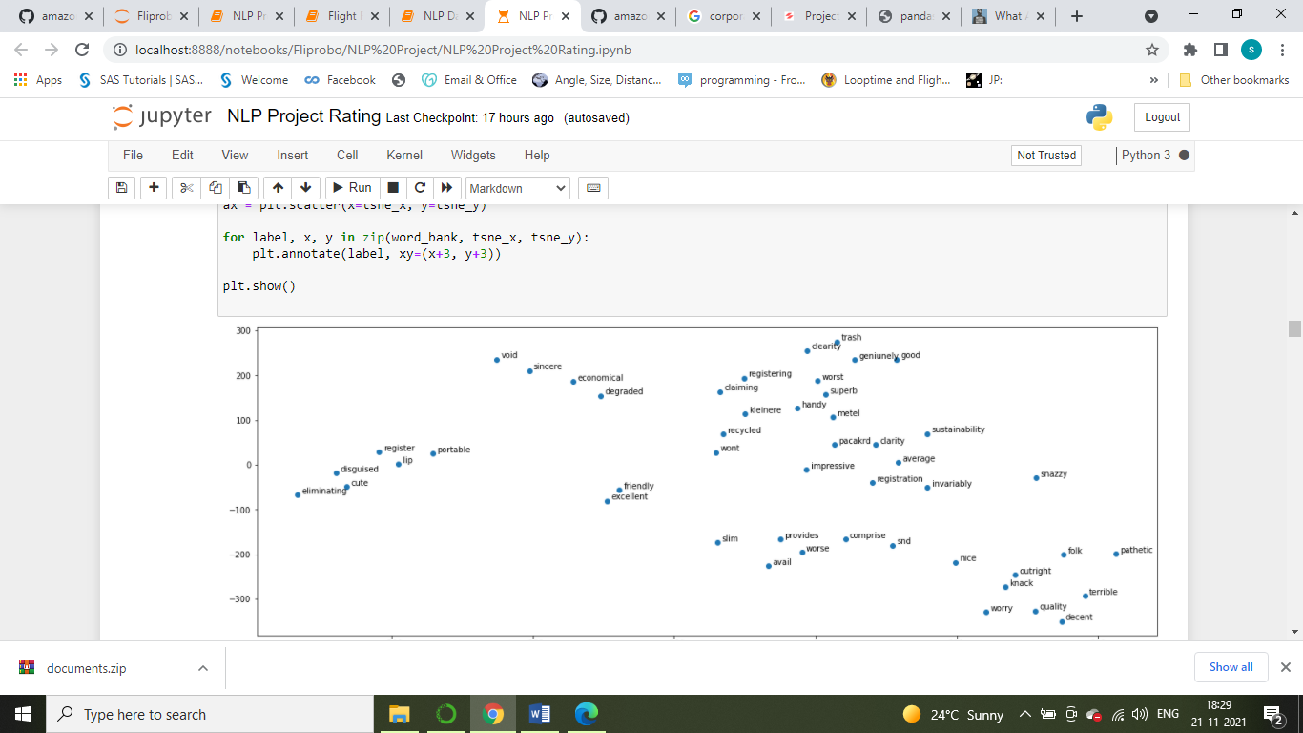
Data Exploration:
T-SNE(T-Distributed Stochastic Neighbour Embedding) :
Like PCA, the t-Distributed Stochastic Neighbour Embedding (t-SNE) is another dimensionality reduction technique that assists in visualizing high-dimensional datasets. To perceive the similarity between the related words in terms of spatial distance, t-SNE provided the coordinates of each word in a 2D scatterplot plane as shown in below figure.

Slide 11
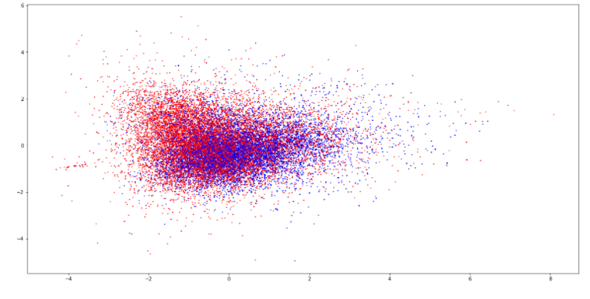
Data Exploration:
PCA (Principal Component Analysis):
Principal Component Analysis (PCA) is a dimensionality reduction technique that we can use on our model to reduce it. This will help visualize if there is a clear decision boundary along the rating classifications. The more datapoints belonging to the same class are clustered together, the higher the likelihood that our machine learning model is simpler and more effective as shown in below fig.

Slide 12
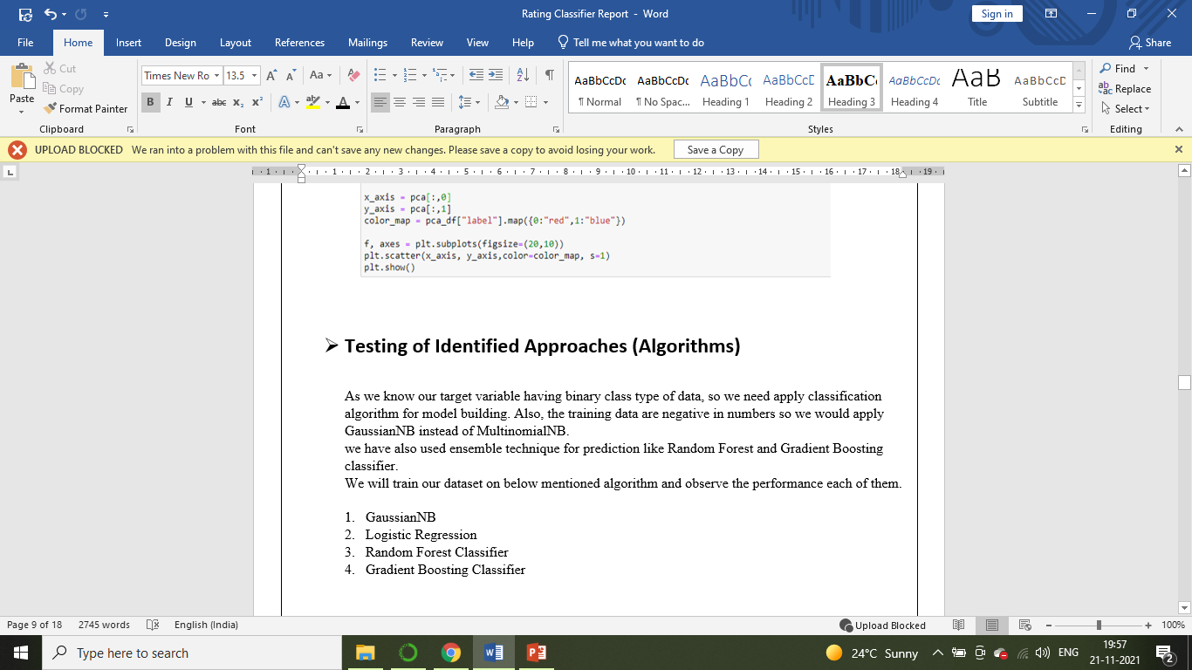
Model Development

Slide 13
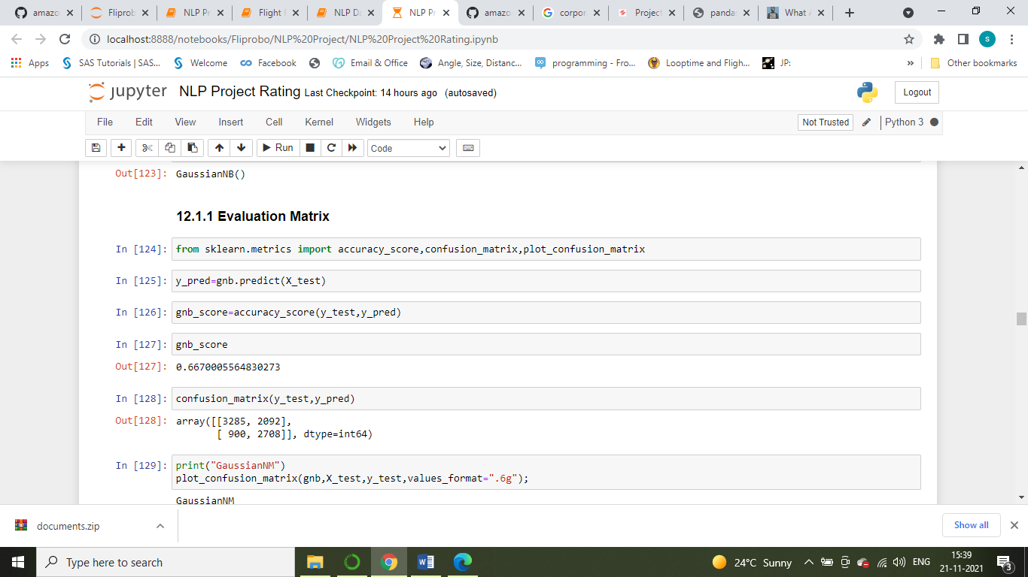
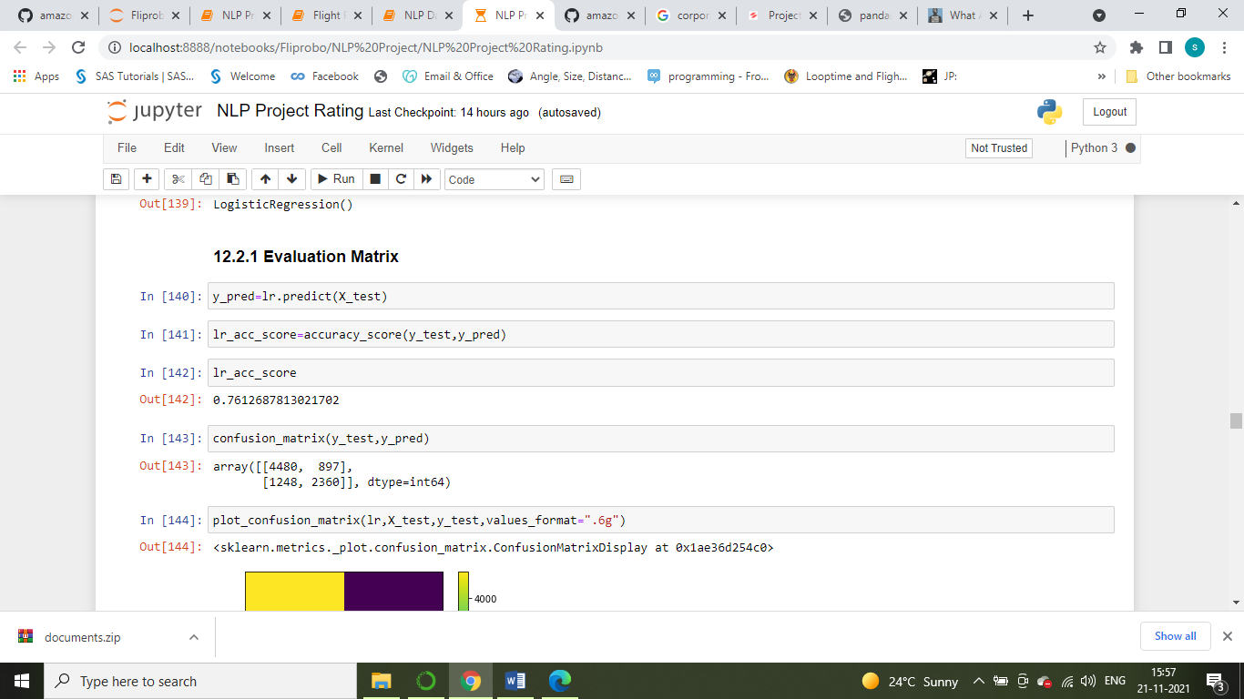
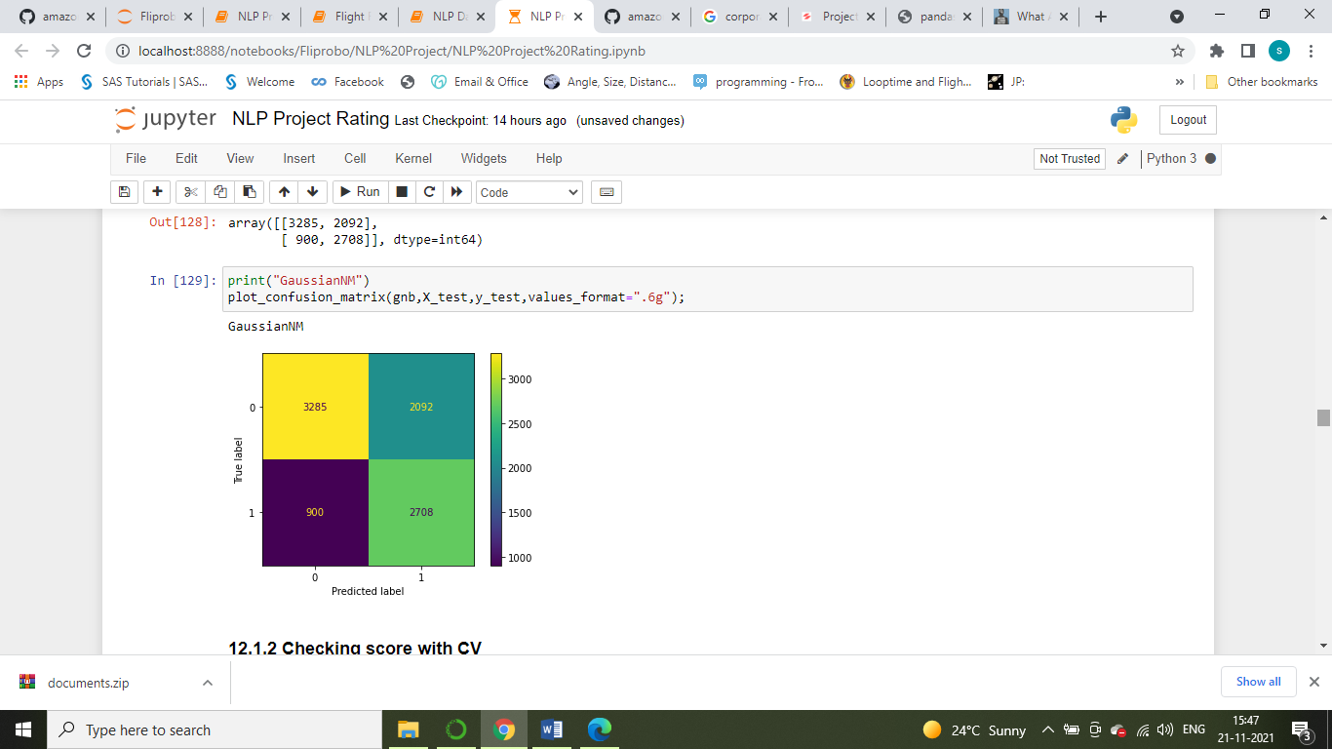
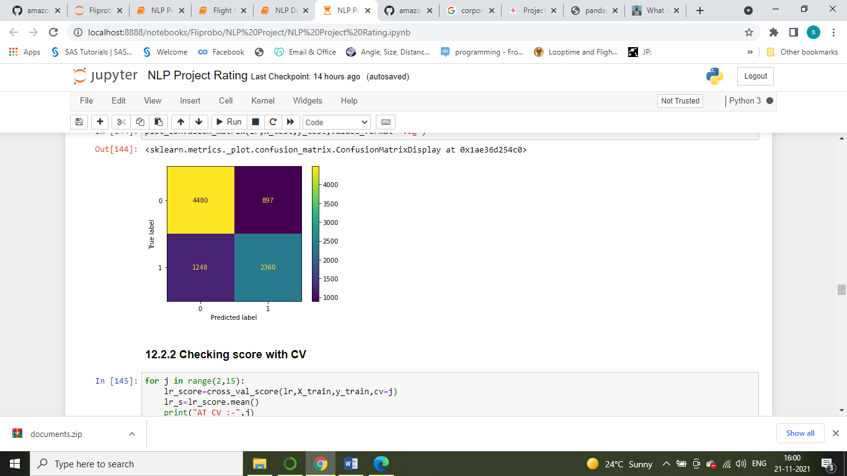
Model Evaluation:
We have evaluated model with Accuracy Score and Cross Validation Score
GaussianNB
Logistic Regression

Slide 14
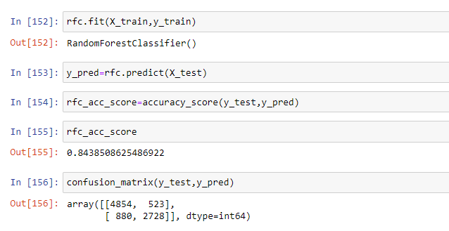
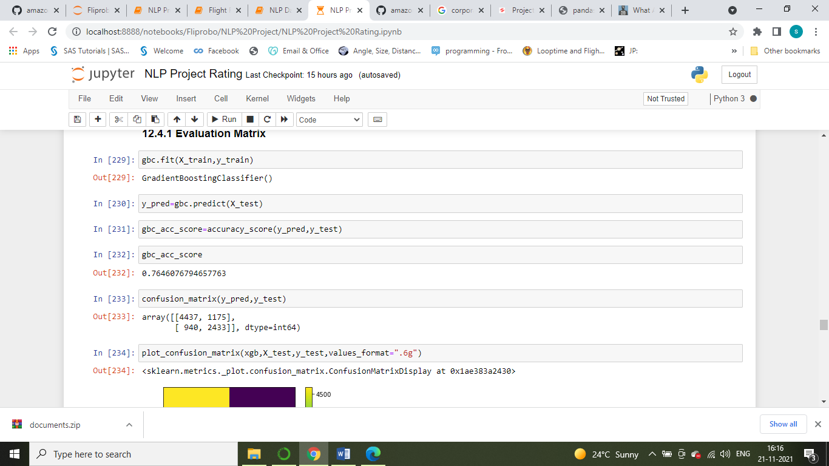
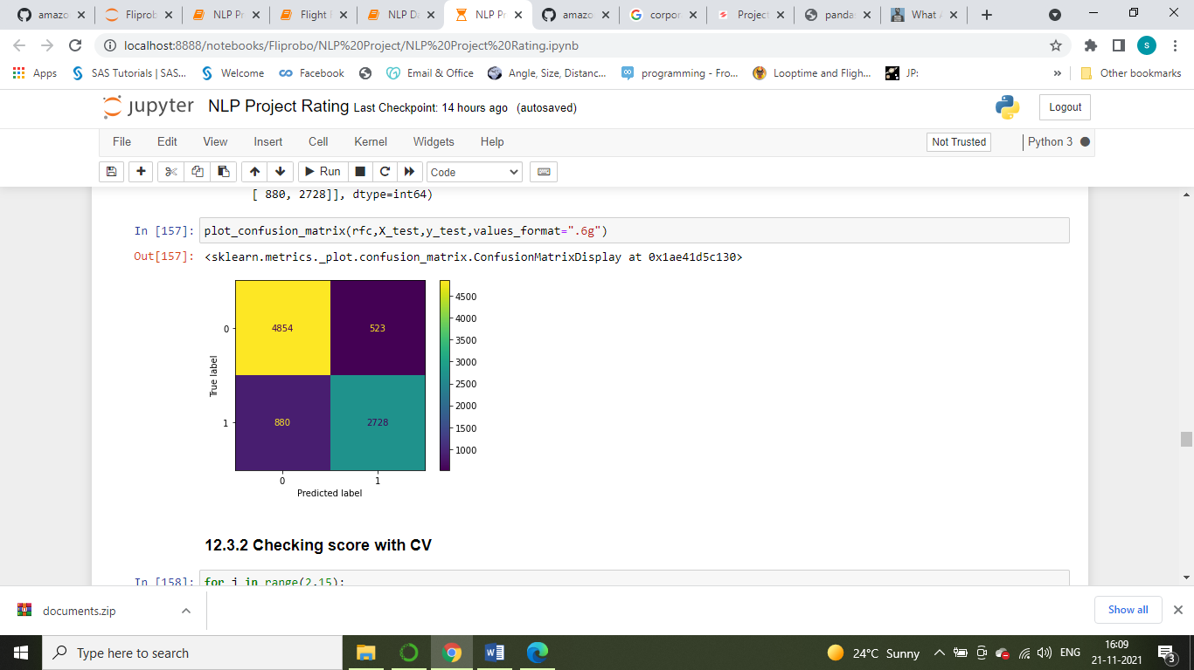
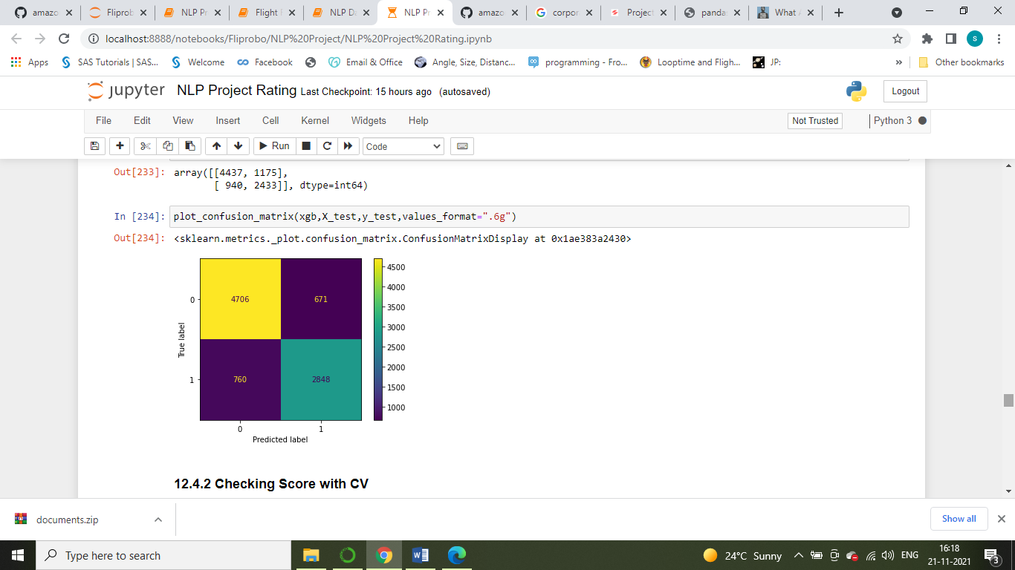
Model Evaluation:
Random Forest Classifier
Gradient Boosting Classifier

Slide 15
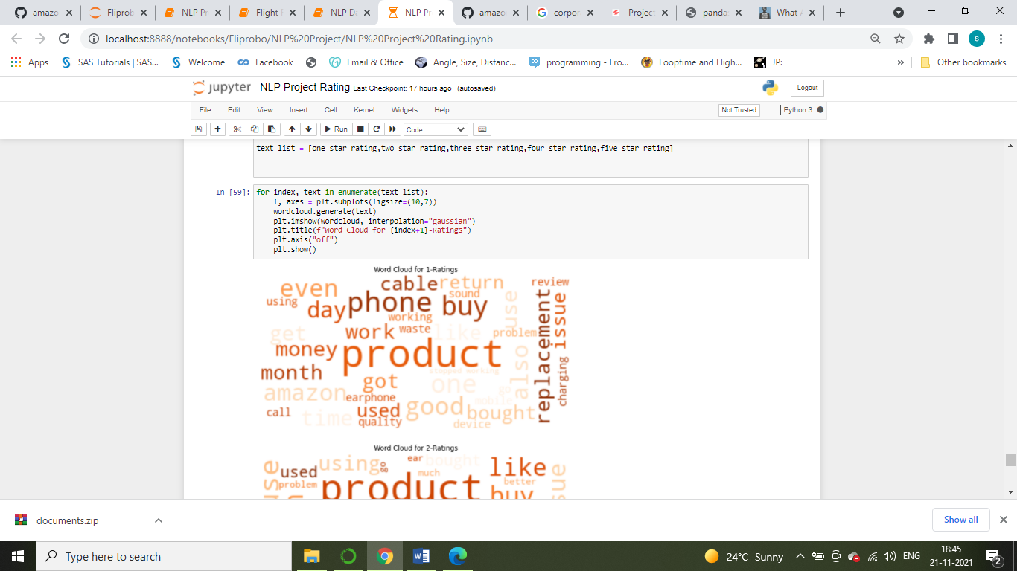
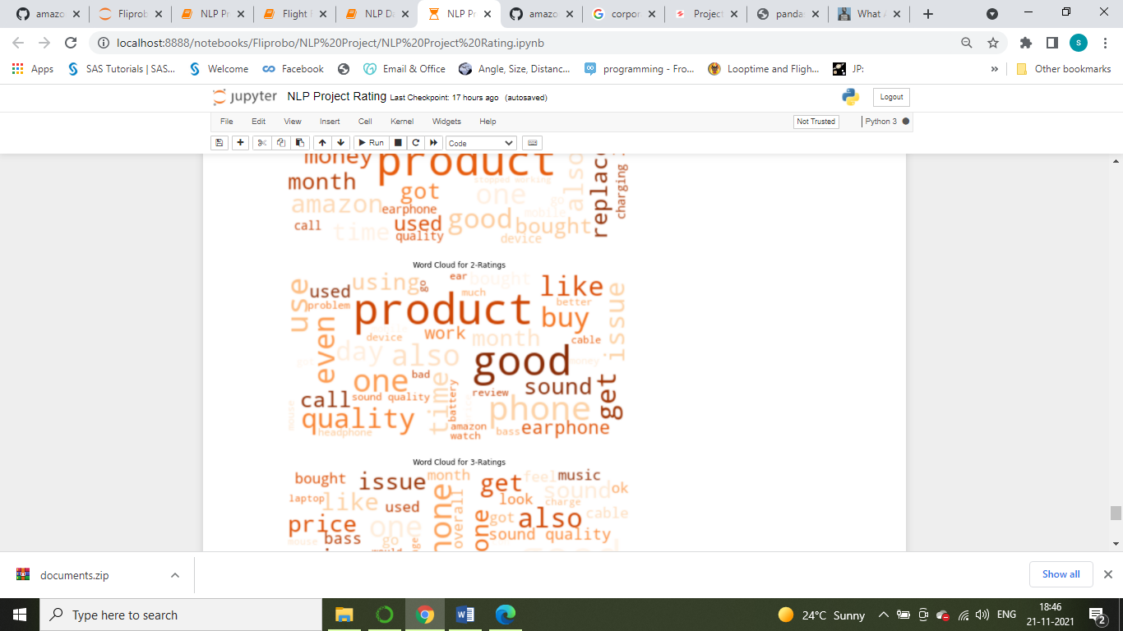
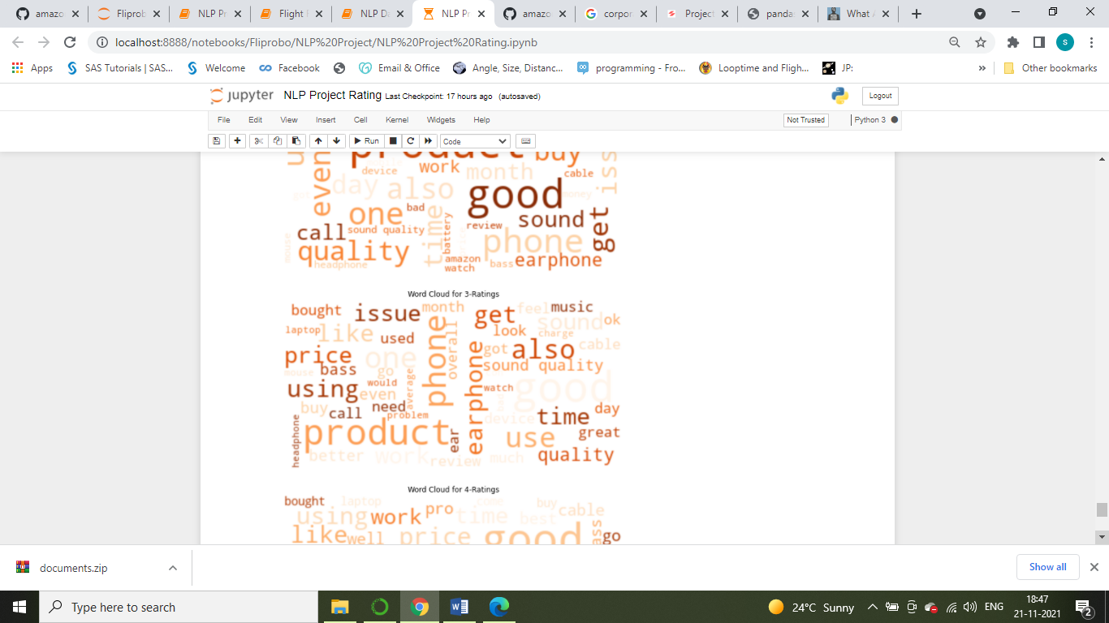
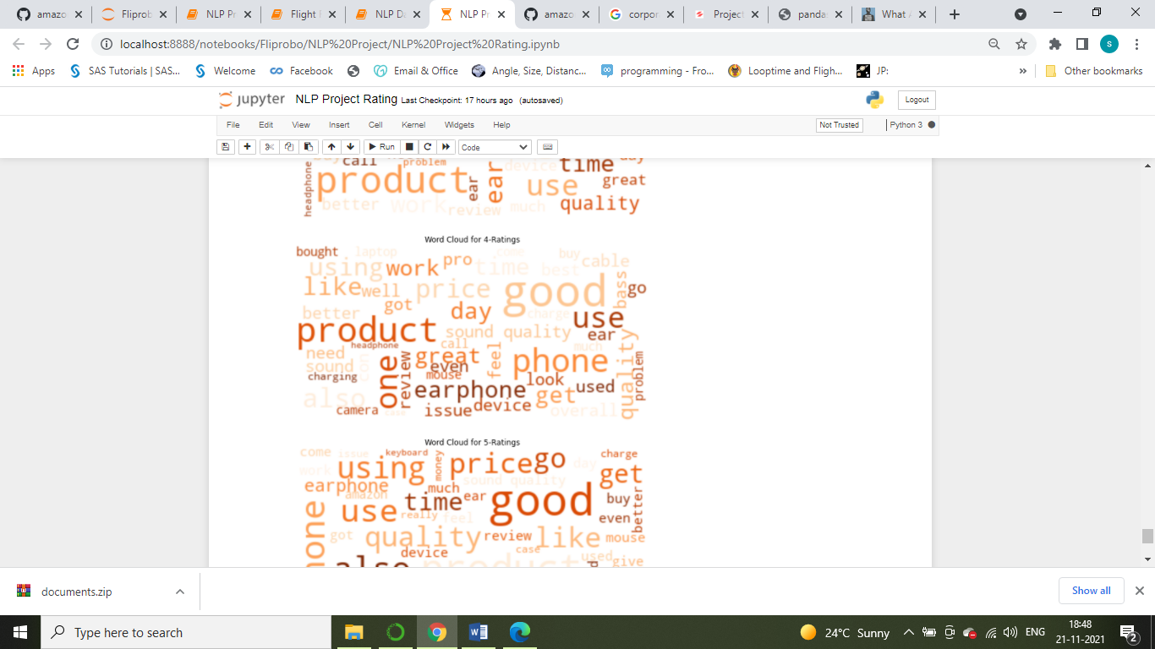
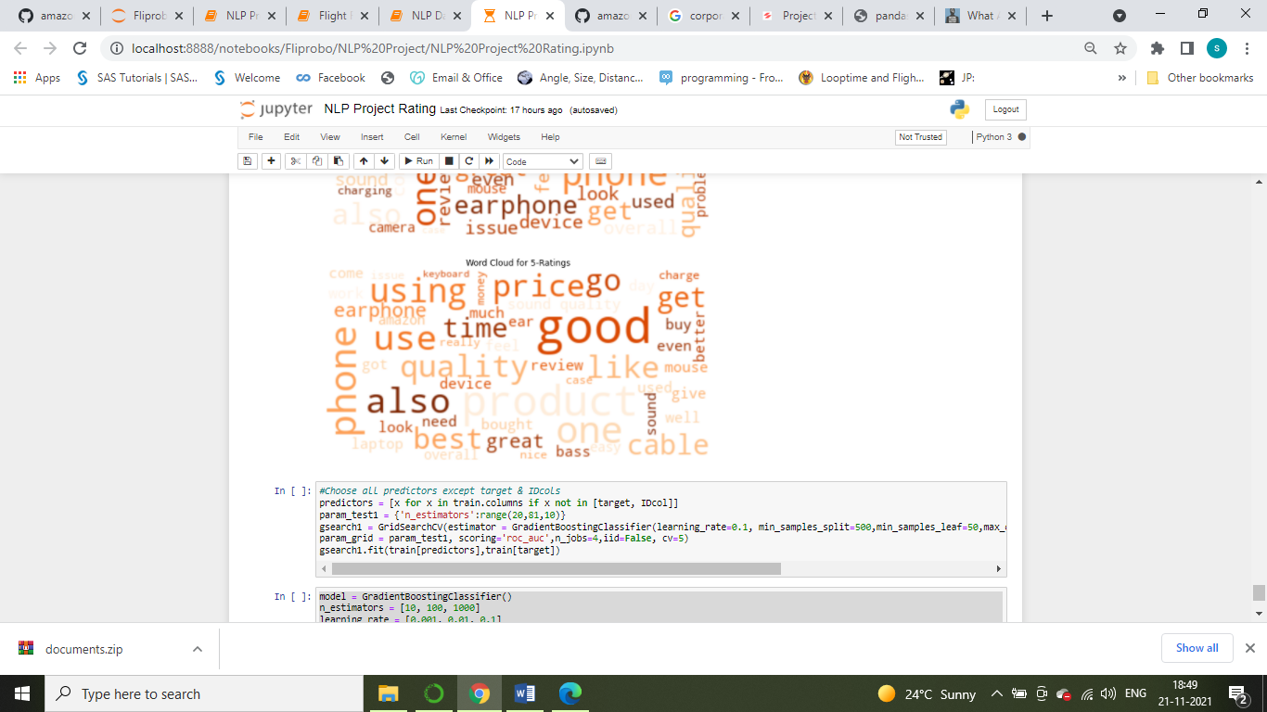
Word Cloud
As shown in below figure, word cloud helps us in visualizing the most important words in each class of target variable i.e. 5Star,4Star,3Star,2Star and 1Star

Slide 16
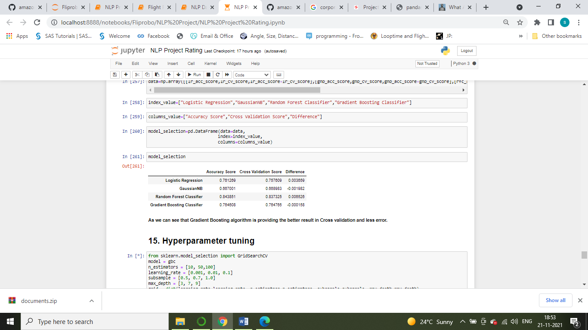
Conclusion
We have shown in below figure Gradient Boosting Classifier algorithm is performing better compared to GaussianNB, Logistic Regression and Random Forest Classifier.
While doing Principal Components Analysis, as shown in Fig 31 we can go with 50 number of components to get more than 90% of variance explained, but we have tried the model performance without PCA applied in model.
We have Confirmed that based on R2 Score, CV Score Gradient Boosting Classifier Model is performing better.

Slide 17
THANK YOU

